Slide 1
Microservices and DevOps
DevOps and Container Technology
Test Doubles
Henrik Bærbak Christensen

Slide 2
Testability
Testability: Concerned with the ease with which the software can be made to demonstrate its faults
Techniques:
Testing:
Review
Manual: Structured and systematic human reading of programs
Static analysis: let programs analyze your program
Formal verification: make profs that you program works

Slide 3
Failure and Defects
What we observe when testing
Why we observe it – the cause
På dansk: Fejl og fejl ☺

Slide 4
Terminology
Test Case
Which means:
We have to isolate some part of the software – the ‘unit’
We have to be able to provide input to the unit
We have to be able to execute the unit with the input and observe the output (which requires a specific context)
We have to know what output to expect (oracle)
(input, output, unit under test)

Slide 5
Conclusion: Testing Issues
Definition: The Testability Input Issue
Embody the issues involved in providing comprehensive and deterministic input to the unit under test in a reliable and reproducible way
Definition: The Testability Unit Isolation Issue
Embody the issues involved in testing a unit under test in isolation in a comprehensive environment in a reliable and reproducible way
Definition: The Testability Output issue
Embody the issues involved in recording the output from a unit under test and asserting the correctness in a reliable and reproducible way

Slide 6
Testability and MSDO
I did not sign up for a test fagpakke, did I?

Slide 7
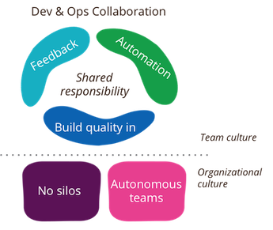
Yes you did ☺
DevOps Culture [Rouan Wilsenach, 2015] (https://www.martinfowler.com/bliki/DevOpsCulture.html)
We need
Fast feedback
Quality Code
Automation
Main technique
Automated regression testing

Slide 8
So – in General
All features/quality attributes should be demonstrated through automated testing in this course
Write JUnit code to validate at unit testing level
Using test doubles to control indirect input and ouput
Write JUnit+TestContainer code to validate at integration testing level
Use real-life containers to handle deterministic input and output
(And test double services or test doubles for non-determ.)

Slide 9
Test Doubles

Slide 10
Motivation
Thorough testing requires software units to be tested in isolation – to create a test harness/environment where defects/complexity in other units do not invalidate/complicate our testing.
The basic idea:
Replace the unit(s) that the ‘unit under test’ collaborates with, with simpler and more controllable units

Slide 11
Terminology
These ‘replacement units’ have many names
Stubs, mocks, test drivers, skeletons, …
(I see a trend that many call everything ‘mocks’ because that is the fancy term ☺. But it is as wrong, as calling a banana for apple just because both are fruits…)
Gerard Meszaros defines a clearer terminology by classifying the various uses of ‘replacements’...
Find it on www

Slide 12
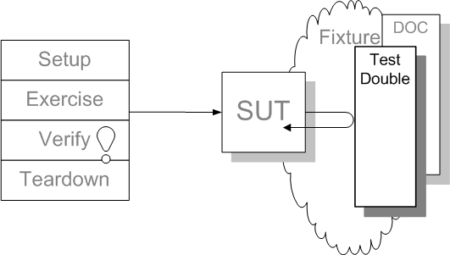
xUnit Pattern: Test Double
“Superclass”: Test Double
SUT: System under test (=UUT)
DOC: Depended-on Component
When?
Slow tests
DOC is
not available
not under test control
has side-effects

Slide 13
Terminology
indirect output
the output a UUT generates, not visible by our driver, but passed as parameters, protocols used, etc., to the DOCs
indirect input
the input a Unit Under Test receives, not by parameter passing, instance variables, etc., but from results computed by DOCs.
Indirect Output
Indirect Input

Slide 14
Test Double
Solution:
Replace DOC with a double
like stunt doubles in movies...
Requires:
that this is possible!!!
GoF’s 1st principle:
Program to an interface...
-
Dependency Injection!

Slide 15
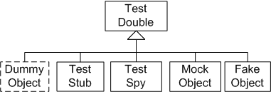
Double classification
Meszaros classify several types of doubles according to the specific testing perspective

Slide 16
The Short Version

Slide 17
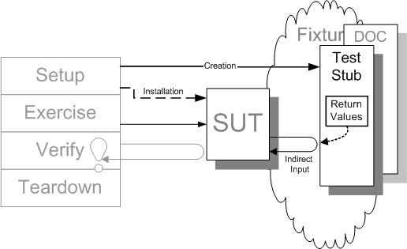
Test Stub
Context
In many circumstances, the environment or context in which the system under test (SUT) operates very much influences the behavior of the SUT. To get good enough control over the indirect inputs of the SUT, we may have to replace some of the context with something we can control, a Test Stub.
Example:
Test that the cooler starts when the temperature is 6 degrees
Stub the temperature sensor with a fixed return value of 6
Notes:
Stubs like

Slide 18
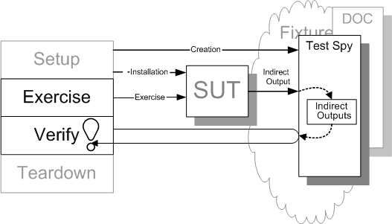
Test Spy
Context:
In many circumstances, the environment or context in which the SUT operates very much influences the behavior of the SUT. To get good enough visibility of the indirect outputs of the SUT, we may have to replace some of the context with something we can use to capture these outputs of the SUT.
Example:
Test that the cooler starts when the temperature is 6 degrees
Replace cooling element with spy, that records when ‘start()’ is called; verify that it was called

Slide 19
Combining
Then our test case of the Cooling, c, may look like
Configure ‘stub = new TemperatureSensorStub(6);’
Configure ‘spy = new CoolingElementSpy();’
Dep inject into Cooler
cooler = new Cooler(stub, spy);
Execute test
cooler.regulateTemperature(); // read temp, if temp>6, start cooling
Validate that cooling element’s start method was called
assertThat(spy.lastInvokedMethod(), is(”start()”))

Slide 20
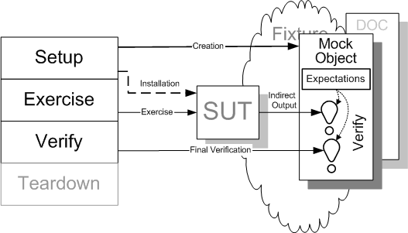
Mock Object
Context:
A test double that verifies the indirect outputs
Usually fail fast semantics
Use a mock library
Mockito, …

Slide 21
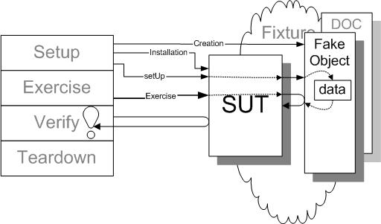
Fake Object
Context:
The SUT often depend on other components or systems. The interactions with these other components may be necessary but the side-effects of these interactions as implemented by the real depended-on component (DOC), may be unnecessary or even detrimental. A Fake Object is a much simpler and lighter weight implementation of the functionality provided by the DOC without the side effects we choose to do without.

Slide 22
Microservice Context
Meszaros’ terminology is founded in a ‘single system’ assumption
I inject a FakeDB implementation of the Database interface, and test my Inventory implementation using that…
But the terminology is independent of the connector between the client and the server
In-process method call connector
Out-of-process REST call connector
So – the stub can be
Java stub implementation
A remote service that provides stub values (ala Mountebank)

Slide 23
Summary
Test Doubles allow you to get access to, inspect, and verify indirect input and output
Stub: focus on indirect input
Spy: focus on indirect output (record/verify)
Mock: focus on indirect output (fail fast)
frameworks to generate doubles dynamically
Fake object: light-weight semi-realistic behaviour

Slide 24
The Long Version

Slide 25
Test Stub

Slide 26
Test Stub
Context
In many circumstances, the environment or context in which the system under test (SUT) operates very much influences the behavior of the SUT. To get good enough control over the indirect inputs of the SUT, we may have to replace some of the context with something we can control, a Test Stub.
Examples:
?
Notes:
Stubs like

Slide 27
Test Stub Examples
Typical examples are
Stubbing sensors or hardware
In a meteorological system it is important to test wind calculations over north when the wind direction changes from 359 degrees to 0 degrees.
Stubbing random behaviour
A dice must be put under test control

Slide 28
Stub variations
Responder
used to inject valid indirect inputs: happy paths
Saboteur
used to inject invalid indirect inputs
Temporary Test Stub
a stand in for a not-yet-implemented DOC – the first TDD production code implementation is always of this kind.
this is what I called a stub in my book...
Entity Chain Snipping
replace a network of objects with a single one

Slide 29
Example 1
In Net4Care we generate XML documents representing telemedicine measurements
Nancy has measured her weight to 77.0 kg
The format is PHMR, a document with a unique ID, generated at the time of creation
<id root="2.16.840.1.113883.3.4208" extension="aa2386d0-79ea-11e3-981f-0800200c9a66"/>
However, comparing with ‘expected’ does not like random IDs ☹
Solution
A UUIDStrategy interface, with a responder implementation

Slide 30
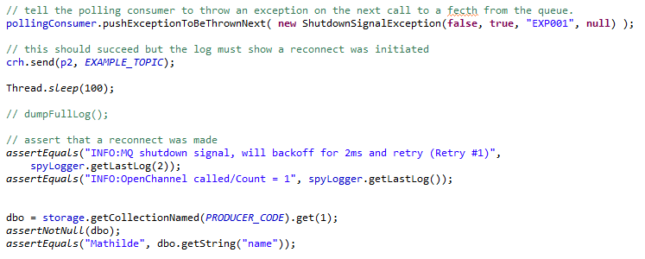
Example 2
In EcoSense Karibu the daemons (responsible for fetching messages from our MessageQueue, converting them to JSON, and storing them in MongoDB), must react properly on MQ exceptions (ie. do a ”fail over”)
Introduce a PollingConsumer interface
A RabbitMQ implementation
A Saboteur implementation – that will throw exceptions

Slide 31
Test Stub
Conclusion:
the primary purpose of the stub is
to control the UUT’s input space
that is
we get testing control over the input space + environment in order to specify test cases
= (input, environment, expected output).
usually has methods/means for the test to specify the returned indirect inputs

Slide 32
Test Spy

Slide 33
Test Spy
Context:
In many circumstances, the environment or context in which the SUT operates very much influences the behavior of the SUT. To get good enough visibility of the indirect outputs of the SUT, we may have to replace some of the context with something we can use to capture these outputs of the SUT.

Slide 34
Test Spy Examples
A Test Spy can
record the parameters passed to it
verify indirect computed output equals expected
the order in which DOC methods were called
verify the protocol between UUT and DOC
A Test Spy does not fail, it merely records interaction.
The Spy is inspected after the test execution in order to verify that indirect output was correct.

Slide 35
Implementation notes
Test Spy inspection variations:
Retrieval interface:
The spy must have additional methods to extract the stored indirect output
Self Shunt:
The test case class itself implements the DOC interface and is thus feed the indirect output directly to be cached in local variables
Inner Test Double
use an inner anonymous class as self shunt

Slide 36
Examples
A classic example is an abstraction that communicates state changes via the Observer pattern
observer notification is an (important!) side-effect of state-changing method calls, but it is not externally visible: it is indirect output
register a SpyListener that counts the number of observer updates received.

Slide 37
Examples
Gerry: An artificial Backgammon player
for all valid moves given board and dice
make move, compute value of board
if (value > bestvalue) { remember this move; }
But does it compute the proper moves? Is it really the best move that is taken?
movehook.considerMove(move);
normally considerMove is the empty method.

Slide 38
Examples
EcoSense Karibu daemons of course log special situations like detected failures of nodes.
A SpyLogger is helpful as it
Verifies that log messages are indeed output
Verifies that failure situations are handled properly

Slide 39
Fake Object

Slide 40
Fake Object
Context:
The SUT often depend on other components or systems. The interactions with these other components may be necessary but the side-effects of these interactions as implemented by the real depended-on component (DOC), may be unnecessary or even detrimental. A Fake Object is a much simpler and lighter weight implementation of the functionality provided by the DOC without the side effects we choose to do without.

Slide 41
Fake Object
Stub versus Fake Object?
Fake Object has “realistic” behaviour, a “lightweight version of the real implementation”
Fake Object is not instrumented/hard-coded with the indirect inputs, instead the indirect inputs comes from previous interactions with the SUT
Not “return 47”, but “return simpleDatastructure[index]”, whose contents is the result of previous interactions (store operations) with the SUT
Less focus on testing aspects of the SUT, more focus on making it work.

Slide 42
Types
Fake Database
replace database with in-memory HashTables
In-Memory Database
semi-real database but not disk-based
(SQLite is brilliant in this respect ☺)
Fake Web Service
hard-coded or table-driven web server
Fake Service Layer
fake the domain layer

Slide 43
Examples
EcoSense Karibu daemons store documents in MongoDB but that is way to heavy for automated testing
StorageStrategy interface with Fake Database

Slide 44
Examples
Net4Care stores PHMR documents in Cross-Enterprise Document Share XDS.b repositories (SOAP web services) which is incredible heavy weight
XDS.b interface with a In-Memory database (SQLite implementation)
Allowed us to TDD the Net4Care framework
Allowed us to supply ‘local lightweight’ servers without the big overhead of getting real XDS.b server running

Slide 45
Mock Object

Slide 46
Mock Object
Context:
A test double that verifies the indirect outputs

Slide 47
Mock Object Workings
Mock objects are somewhat more complex to define but are powerful to verify UUT behaviour with respect to the DOC.
Define Mock object with same interface as DOC
Configure mock with expectations
values to return (like test stub)
the methods that must be called
including sequence/protocol and call count
expected parameters
The mock will fail if these expectations are not met
fail fast!
Thus test driver needs not verify anything!

Slide 48
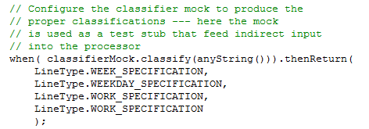
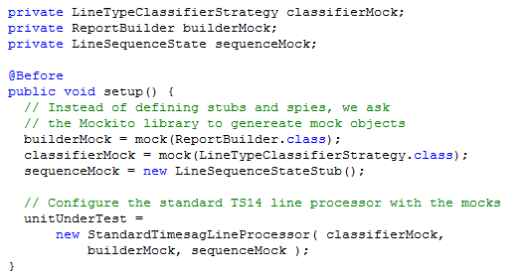
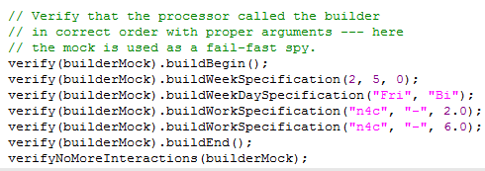
Mock Libraries
Mocks are special in the sense that they are dynamically created by a Mock library

Slide 49
Considerations
Mock objects must be programmed in advance
thus we must be able to predict UUT indirect output in advance – a hard-core whitebox requirement...
But pretty OK in a TDD context where you actually program the production code along with the test code.
Mock objects are responsible for failing
thus exceptions thrown must be able to pass out of the UUT
may not be possible if it is embedded in a EJB container or similar...

Slide 50
MicroService Context
It is all so in-memory right?

Slide 51
Meszaros
Meszaros’ terminology is founded in a ‘single system’ assumption
I inject a FakeDB implementation of the Database interface, and test my Inventory implementaion using that…
But the terminology is independent of the connector between the client and the server
In-process method call connector
Out-of-process REST call connector
So – the stub can be
Java stub implementation
A remote service that provides stub values (ala Mountebank)

Slide 52
Summary
Testing units in isolation is important
unit and integration testing
test-driven development
Units have more inputs and outputs than visible from the parameter list and instances variables
especially true in object-oriented programming
indirect inputs: data from DOCs
indirect output: data to DOCs

Slide 53
Summary
Test Doubles allow you to get access to, inspect, and verify indirect input and output
Stub: focus on indirect input
Spy: focus on indirect output (record/verify)
Mock: focus on indirect output (fail fast)
frameworks to generate doubles dynamically
Fake object: light-weight semi-realistic behaviour

